Slide 1
AI Face Recognizer with Jetson Nano
2022 Mike Soniat

Slide 2
Detection vs Recognition
Face Detection looks at a frame, image, or video and identifies if and where human faces are present. It doesn't matter to who the faces belong to.
Facial Recognition is the process of identifying or verifying the identity of a person using their face. It captures, analyzes, and compares patterns based on the person's facial details.

Slide 3
Project
Build a Python program that can recognize faces in photos
Use OpenCV library for computer vision
Use the Jetson Nano Developer Kit
Use open source Dlib machine learning library
Use open-source Python face-recognition library
Train the program on known faces
Recognize those trained faces in random photos

Slide 4

OpenCV
OpenCV is an open-source computer vision and machine learning software library.

Slide 5
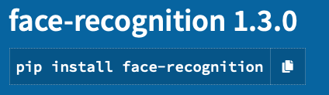
face-recognition 1.3.0
Recognize and manipulate faces from Python or from the command line with
the world’s simplest face recognition library. Built using Dlib’s state-of-the-art face recognition. Built with deep learning, the model has an accuracy of 99.38%

Slide 6

Dlib
Dlib is a modern C++ toolkit containing machine learning algorithms and tools for creating complex software in C++ to solve real world problems. It is used in both industry and academia in a wide range of domains including robotics, embedded devices, mobile phones, and large high performance computing environments. Dlib’s open-source licensing allows you to use it in any application, free of charge.

Slide 7
Pickle - Python object serialization
The pickle module implements binary protocols for serializing and de-serializing a Python object structure. “Pickling” is the process whereby a Python object hierarchy is converted into a byte stream, and “unpickling” is the inverse operation, whereby a byte stream (from a binary file or bytes-like object) is converted back into an object hierarchy. Pickling (and unpickling) is alternatively known as “serialization”, “marshalling,” 1 or “flattening”; however, to avoid confusion, the terms used here are “pickling” and “unpickling”.

Slide 8
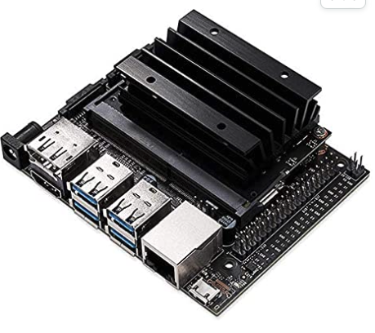
Main Components
NVIDIA Jetson Nano Developer Kit
This developer kit is a small, powerful computer that lets you run multiple neural networks in parallel for applications like image classification, object detection, segmentation, and speech processing. All in an easy-to-use platform that runs in as little as 5 watts.

Slide 9
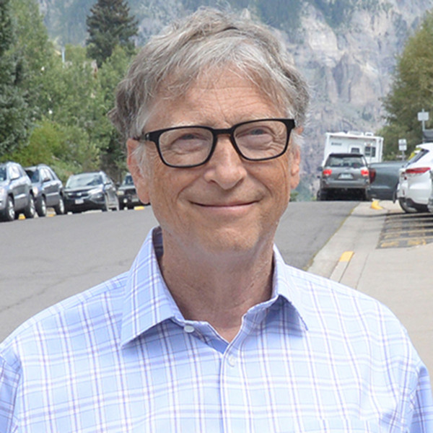

Training Images
Bill Gates.jpg
Steve Jobs.jpg

Slide 10
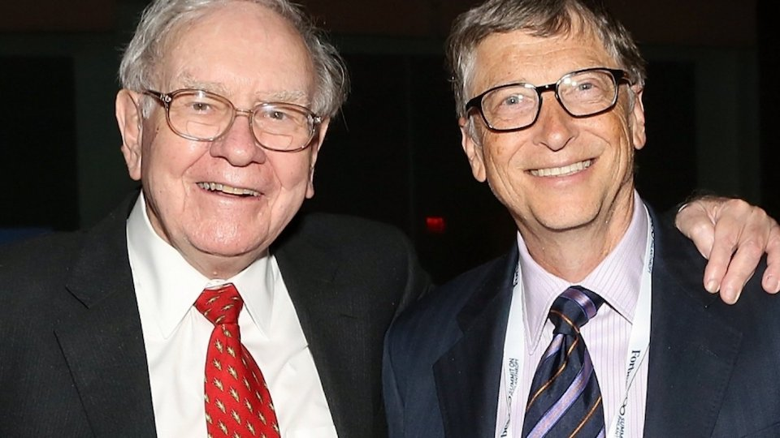
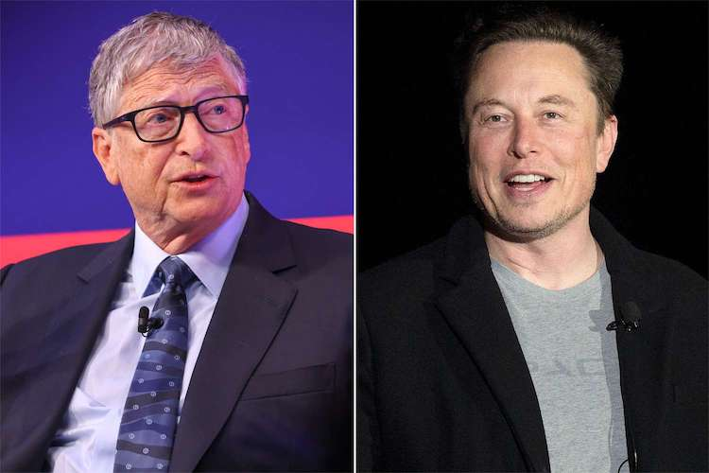
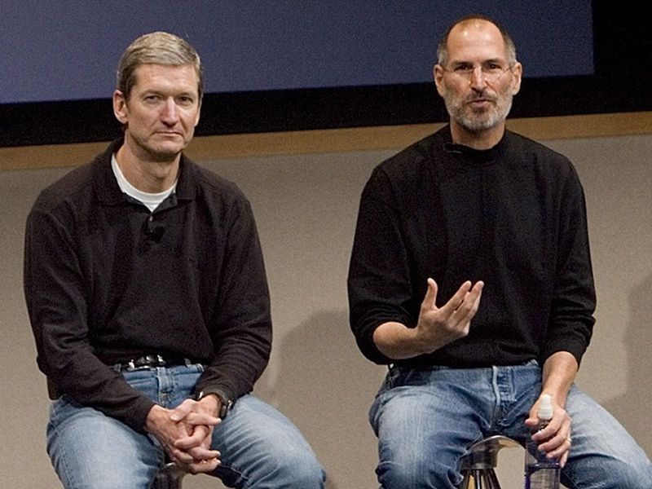
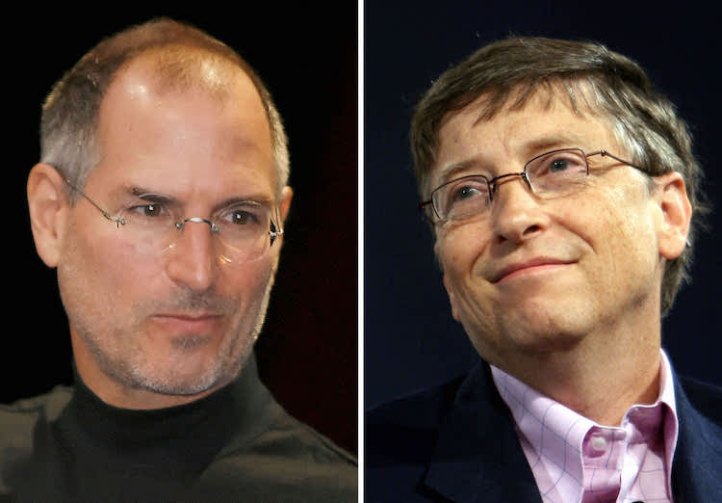
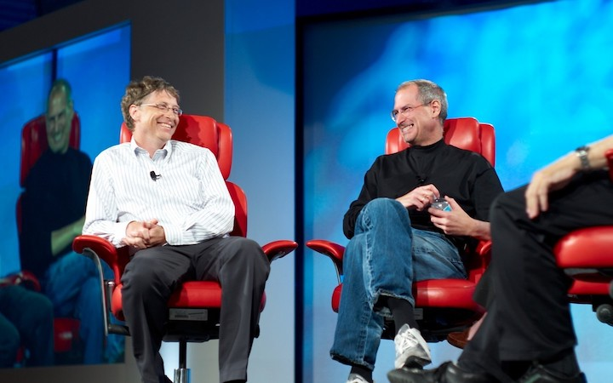
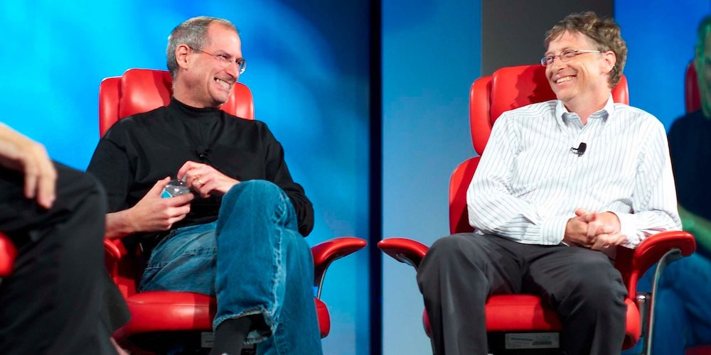
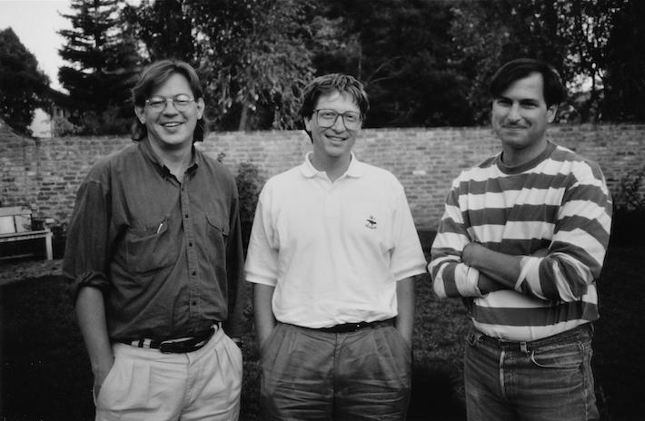
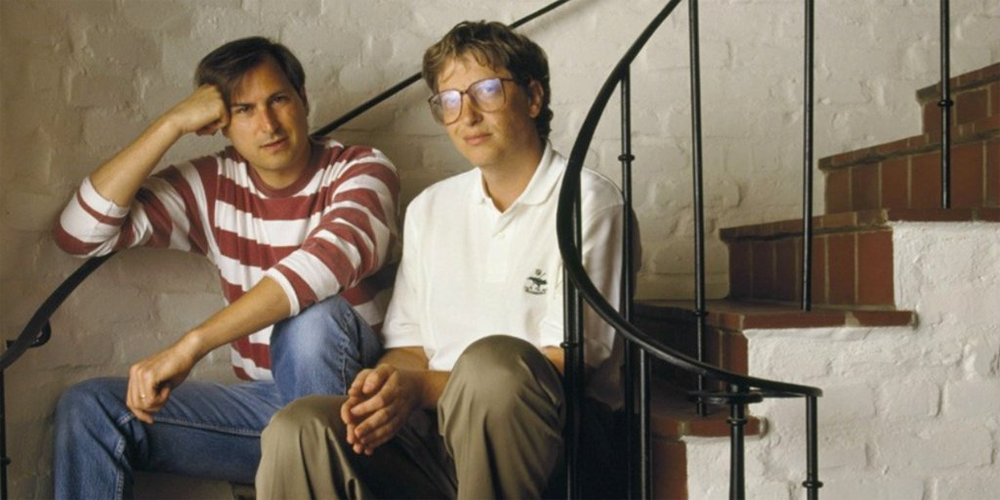
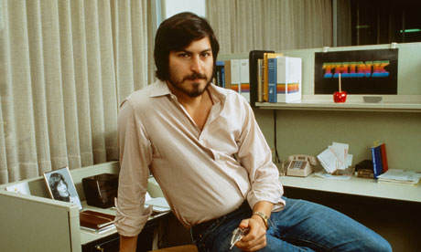
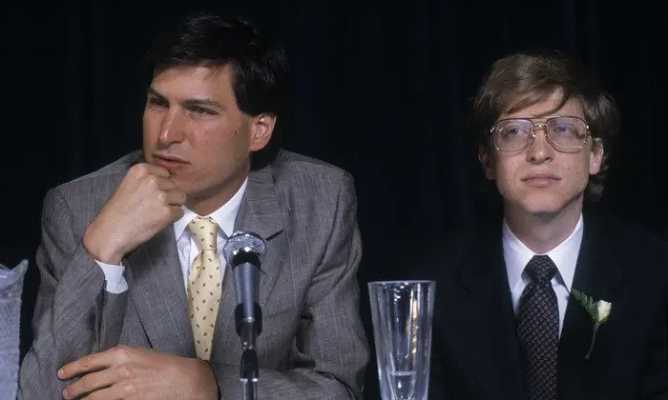
Testing Images

Slide 11
Live Demo

Slide 12
Results

Slide 13
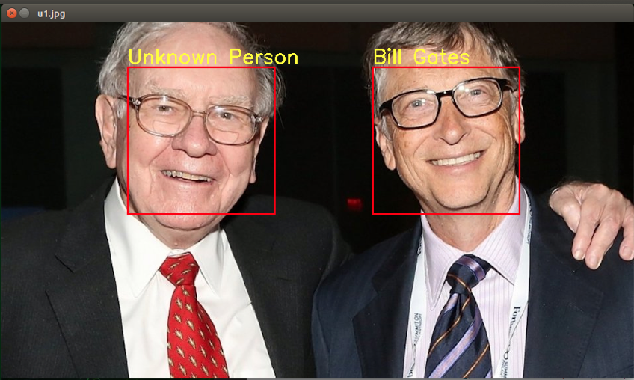
Training Images
Testing Image

Slide 14
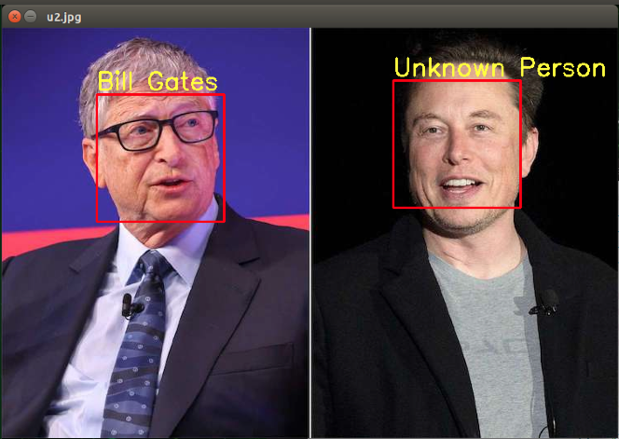
Training Images
Testing Image

Slide 15
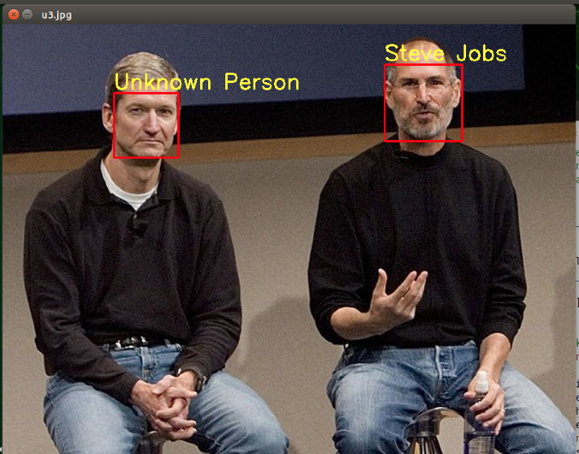
Training Images
Testing Image

Slide 16
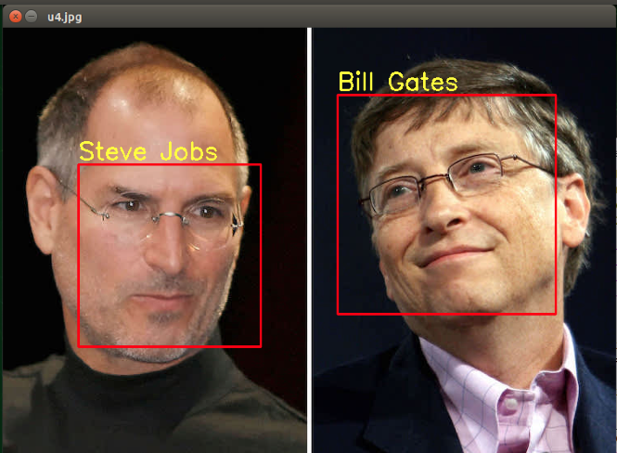
Training Images
Testing Image

Slide 17
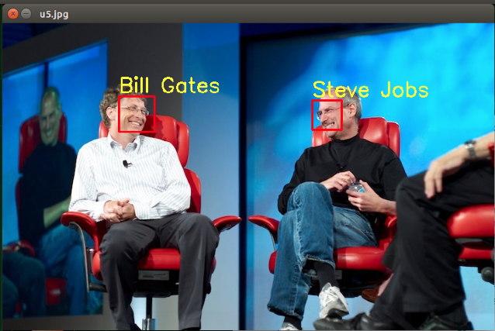
Training Images
Testing Image

Slide 18
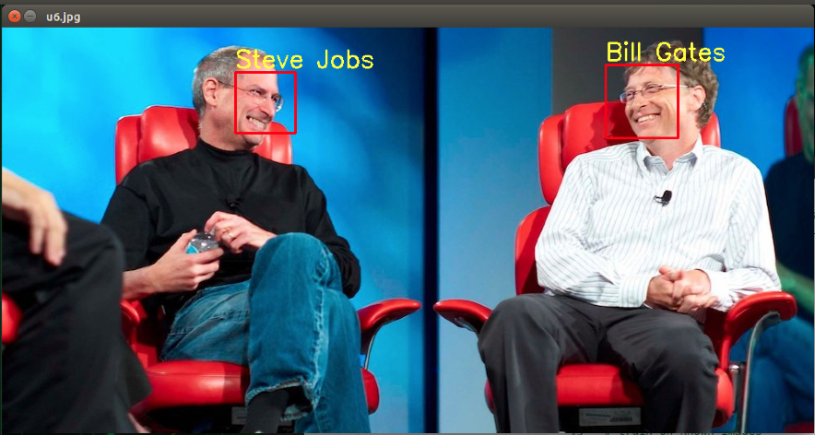
Training Images
Testing Image

Slide 19
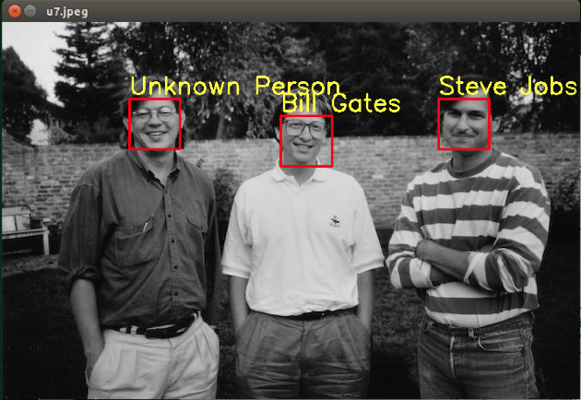
Training Images
Testing Image

Slide 20
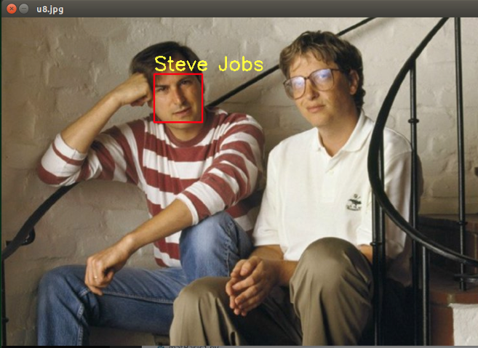
Training Images
Testing Image

Slide 21
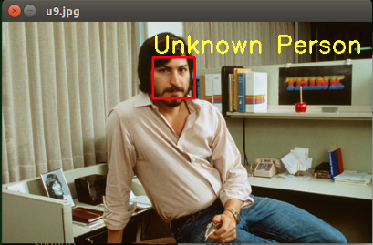
Training Images
Testing Image

Slide 22
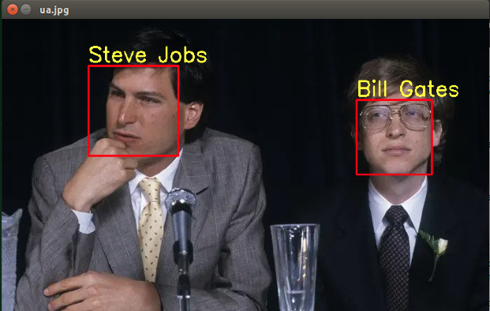
Training Images
Testing Image

Slide 23
Next Steps…
Next, I’ll work on identifying faces in live video rather than just still photos.
I’d like to use the Jetson Nano to identify and label the members of our group.
This week, I’ll take some screen shots in our Zoom meeting.
Hopefully, I’ll be able to show a live demo next week where each person will be identified and labeled in real-time.

